Slide 1

Google Data Analytics Capstone Project: Cyclistic Case Study
By Dimas Saptoaji

Slide 2
Background
Business Model:
A bike-sharing business located in Chicago
2 types of customers based on ticket purchases:
Casual Members (One-way or full-day rental)
Annual Members (Annual rental)
Competitive Advantages:
Pricing flexibility
Variety of bicycle types to cover a wide customer segmentation
Product Background:
Has a fleet of 5824 bicycles and 692 stations.
30% of users use bicycles to commute to work every day, the rest use bicycles for leisure purpose.

Slide 3
Stakeholders
Stakeholders | Responsibilities
Lily Moreno (Marketing Director) | Development of campaigns and initiatives to promote bike-sharing programs
Marketing Analytics Team | Collect, analyze, and report information that guides marketing strategy
Executive Team | Make decisions on recommended marketing programmes

Slide 4
Problems
Cyclistic's financial analysts have concluded that annual members are more profitable than regular riders. Although pricing flexibility has helped Cyclistic attract more customers. Marketing director, Moreno, considers increasing the number of annual members as the key to future growth. She suggests focusing on the strategy of converting Casual Members into Annual Members rather than targeting new customers, which if successfully implemented will increase the company's revenue sustainably in the future.

Slide 5
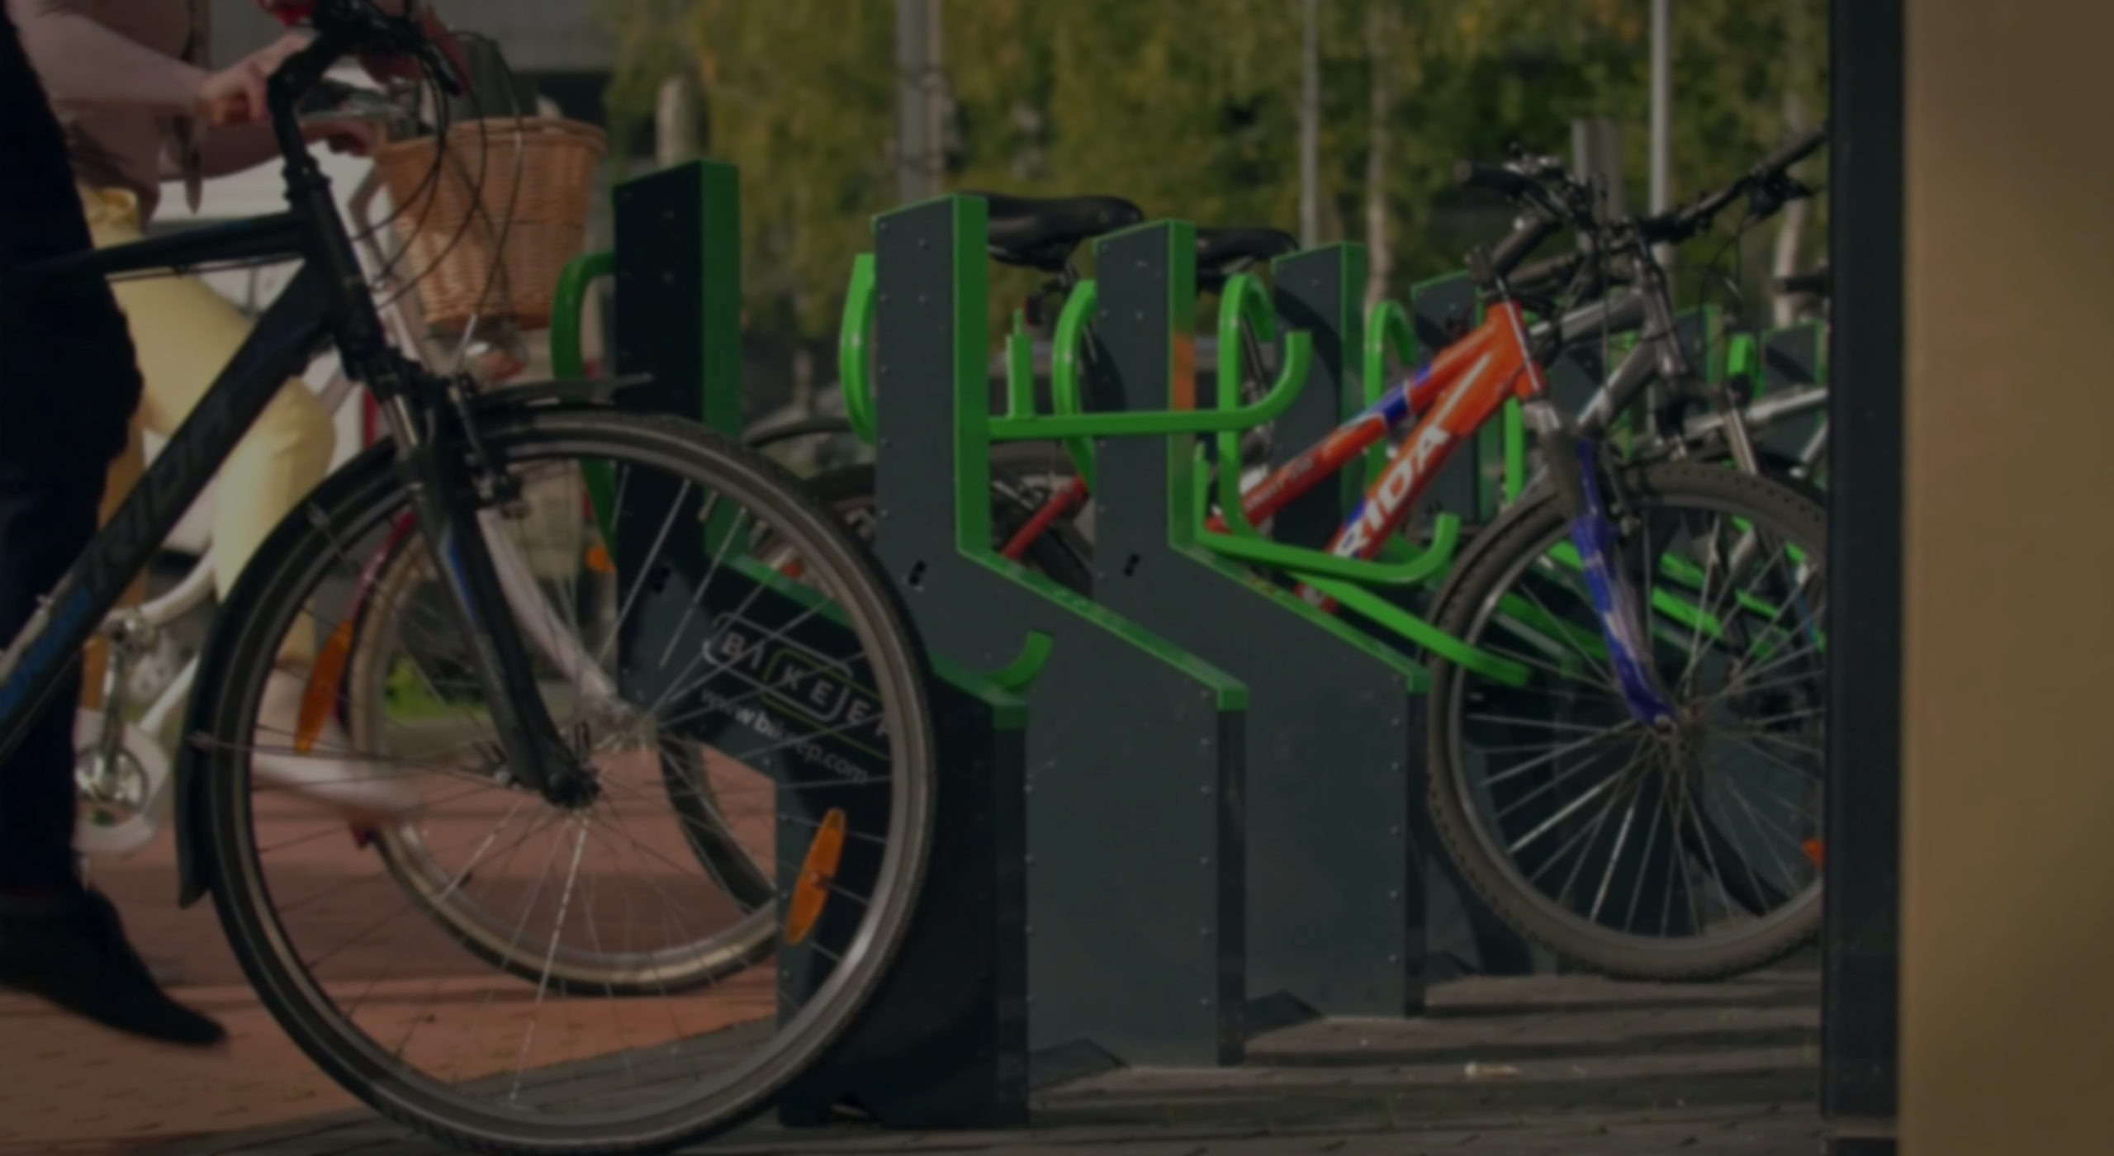
Analysis
Using SQL and Tableau

Slide 6
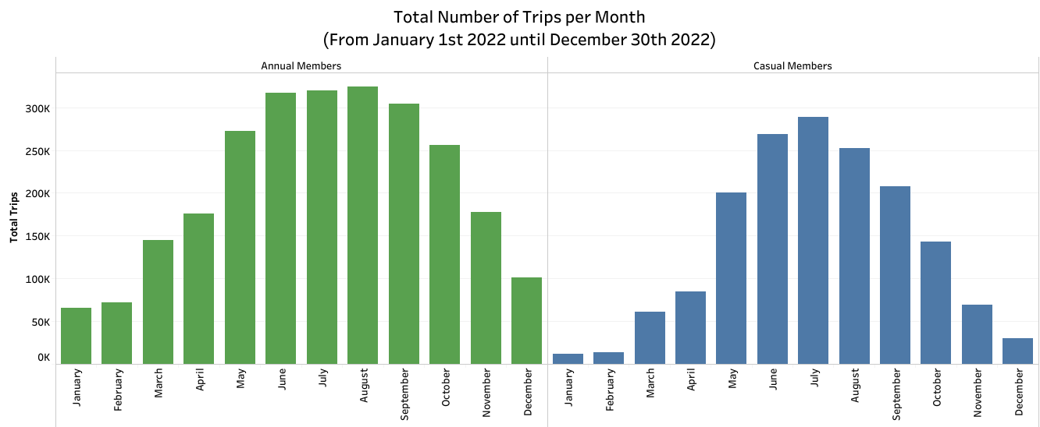
Annual Members and Casual Members riders made more trips in June, July, and August. It’s possible that the users chose these three months to enjoy the summer holidays.

Slide 7
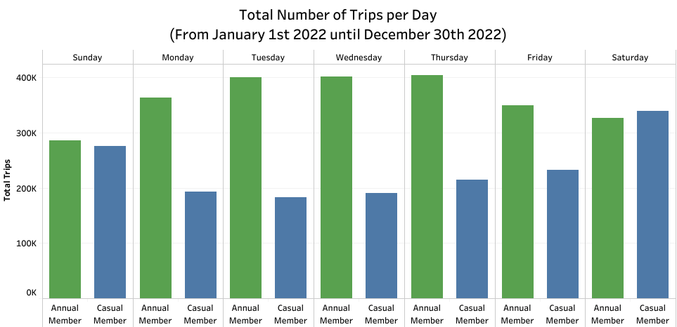
For Casual Members the biggest volume of trips was on Saturday and then Sunday. So the volume for Casual Members was at its highest on the weekend and dropped during the weekdays.
For Annual Members the biggest volume of trips was on Thursday and then Wednesday and also tend to have large volumes on weekdays. This indicates that many Annual members use bicycles to commute to and from work on a daily basis.

Slide 8
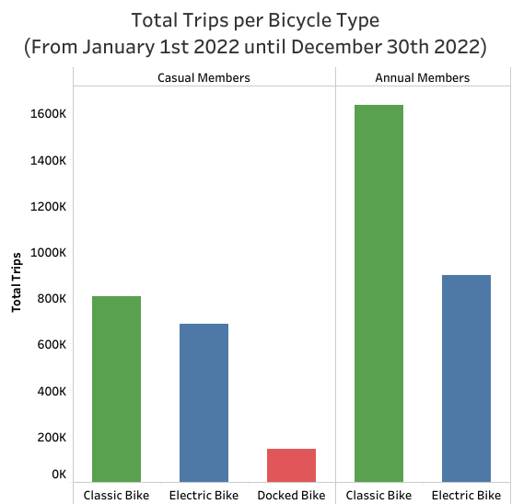
Both Casual and Annual Members prefer to use Classic Bike. This means that Classic Bikes might become the most marketable bikes to use when advertising Cyclistics

Slide 9
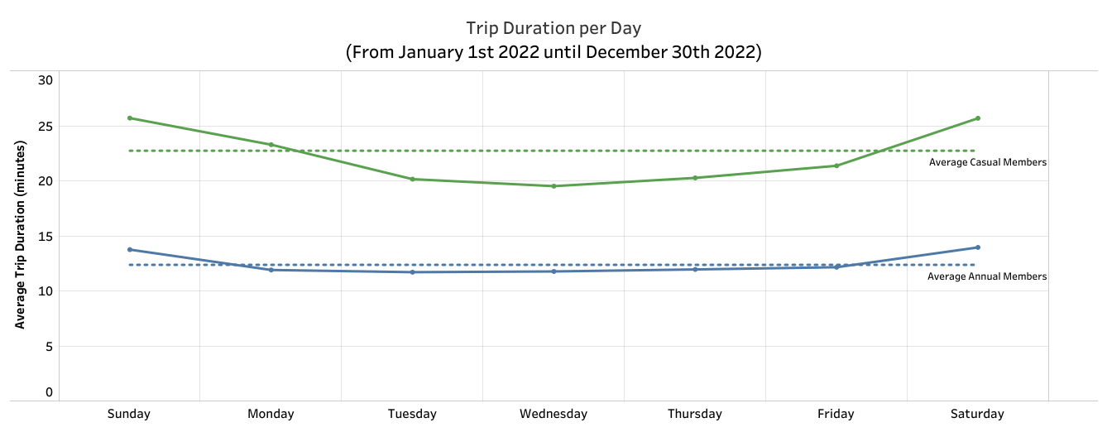
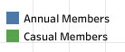
Casual members have 1,04 times longer trip duration than Annual Members. There is an increase in average trip duration on weekends (Saturday and Sunday).

Slide 10
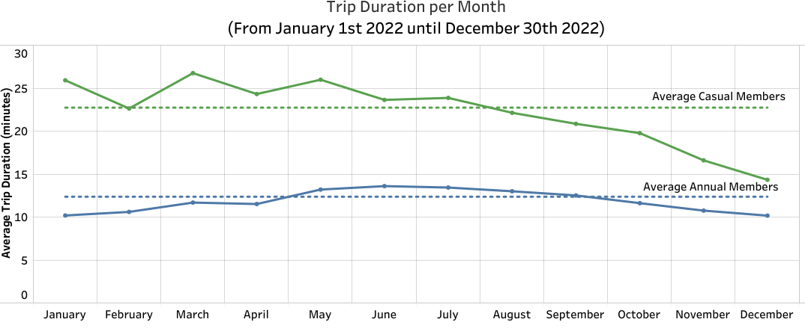
Casual members also have a trip duration per month 1,01 times longer than Annual Members. There was a significant decrease in average trip duration in August-December. Where in August is the end of summer then enters the fall season in September-November and continued by winter in December

Slide 11
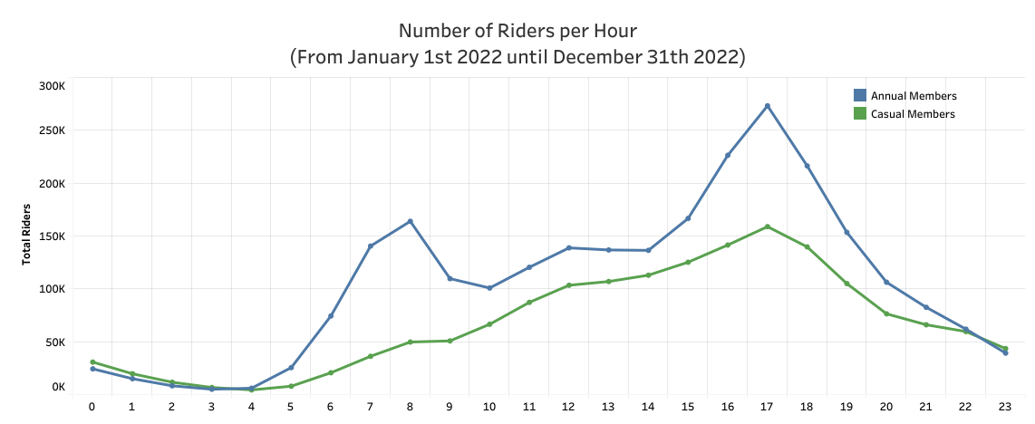
The highest number of riders, both casual members and annual members, took place from 3pm to 7pm. During this time, it is likely that most of them use this time to relax after a full day of work. This is the best time to launch the campaign.
During peak hours at 8am annual members dominate, while casual members experience a significant increase at 5pm. This shows that most annual members use the bicycle for their daily commute to and from work. While most of the casual members use bicycles for fun and recreation.

Slide 12
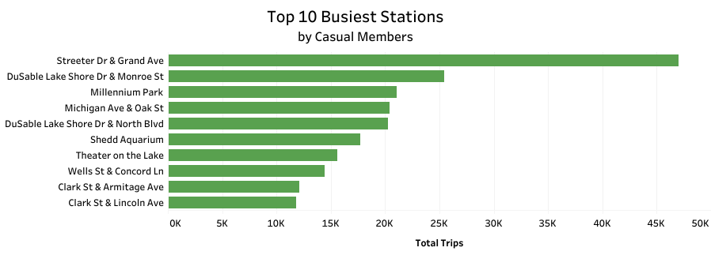
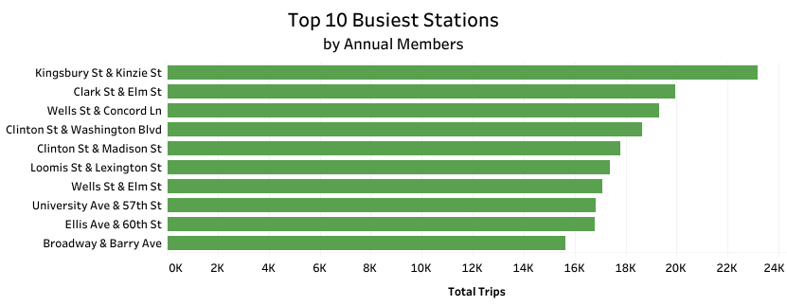
The busiest station with the highest density of casual members is at Streeter Dr & Grand Ave where the station has a significantly different density of casual members compared to other stations.
This is one of the perfect places to launch the campaign, and we can't skip the campaign for the other nine stations either.

Slide 13
Act

Slide 14
Recommendations
Time Aspects
Weekends between 8am and 5pm are the best times to run the campaign.
The summer season, from June to August, is the optimal time to launch the campaign.
Bike Type Aspects
Never promote the docked bike type.
Keep the promotion focused on classic bike and electric bike type.
Place Aspect
Do the campaign at Streeter Dr & Grand Ave station.
Duration Aspect
Do campaigns for casual members who have short trips duration.

Slide 15
Recommendations
Another Aspect
Providing discounts and incentives may also have the opportunity to increase revenue. For example, by providing discounts for annual membership users, providing incentives for new annual membership users who have just joined. This will make it more attractive for casual membership users to join the annual membership. Then adding membership types such as weekly or monthly membership can also target customers who are constrained by economic problems to subscribe to annual membership.

Slide 16
Thank You

